Slide 1
NLP Pipeline

Slide 2
A simple NLP model typically exists out of 3 steps
Preprocessing
Embedding your string
Training your model

Slide 3

Example: document retrieval
How do I make my child eat its medicine?
How do I make my cat eat its medicine?
How to make my cat eat its medicine?
I have problems giving my Bengal its pill

Slide 4
Embed your string
First we need to transform our words into a string

Slide 5
Approach 1: Bag of Words
We can vectorize every sentence by counting how often a certain word occurs in that sentence.
how | do | I | make | my | cat | eat | its | medicine | child | to | have | problems | giving | Bengal | pill
1 | 1 | 1 | 1 | 1 | 1 | 1 | 1 | 1 | 0 | 0 | 0 | 0 | 0 | 0 | 0
1 | 1 | 1 | 1 | 1 | 0 | 1 | 1 | 1 | 1 | 0 | 0 | 0 | 0 | 0 | 0
1 | 0 | 0 | 1 | 1 | 1 | 1 | 1 | 1 | 0 | 1 | 0 | 0 | 0 | 0 | 0
0 | 0 | 1 | 0 | 1 | 0 | 0 | 1 | 0 | 0 | 0 | 1 | 1 | 1 | 1 | 1

Slide 6
Example: document retrieval
How do I make my child eat its medicine?
1
How do I make my cat eat its medicine?
How to make my cat eat its medicine?
2
I have problems giving my Bengal its pill
3

Slide 7
Approach 1: Bag of Words
We can vectorize every sentence by counting how often a certain word occurs in that sentence.
Advantage | Disadvantage
Very easy to calculate Case independant | Does not take into account word order Every word is evenly important Does not take into account word meaning

Slide 8
Approach 2: TF-IDF
Goal:
Use a score to highlight each word’s relevance in the entire document.
Term Frequency - Inverse Document Frequency
= evaluate the words used in a sentence and measures it’s usage compared to words used in the entire corpus.
how | do | I | make | my | cat | eat | its | medicine | child | to | have | problems | giving | Bengal | pill
0.35 | 0.43 | 0.35 | 0.35 | 0.28 | 0.43 | 0.35 | 0.28 | 0.35 | 0 | 0 | 0 | 0 | 0 | 0 | 0
0.33 | 0.4 | 0.33 | 0.35 | 0.27 | 0 | 0.33 | 0.27 | 0.33 | 0.51 | 0 | 0 | 0 | 0 | 0 | 0
0.33 | 0 | 0 | 0.33 | 0.27 | 0.40 | 0.33 | 0.27 | 0.33 | 0 | 0.51 | 0 | 0 | 0 | 0 | 0
0 | 0 | 0.33 | 0 | 0.22 | 0 |  | 0.22 | 0 | 0 | 0 | 0.42 | 0.42 | 0.42 | 0.42 | 0.42

Slide 9
Example: document retrieval
How do I make my child eat its medicine?
2
How do I make my cat eat its medicine?
How to make my cat eat its medicine?
1
I have problems giving my Bengal its pill
3

Slide 10
Approach 2: TF-IDF
We can vectorize every sentence by counting how often a certain word occurs in that sentence.
Advantage | Disadvantage
Not too difficult to calculate Matches sentences based on important words | Does not take into account word order Every word is evenly important Case dependant

Slide 11
Approach 3: Word Embeddings
The (imperfect) way we assign meaning to words: By placing them relative to other words.
This is what we call an embedding
A simple example of embedding would be placing all the words on a scale from very mean to very kind
dumb
mad
good
nice
great
very mean
very kind
This is a 1-dimension embedding !

Slide 12
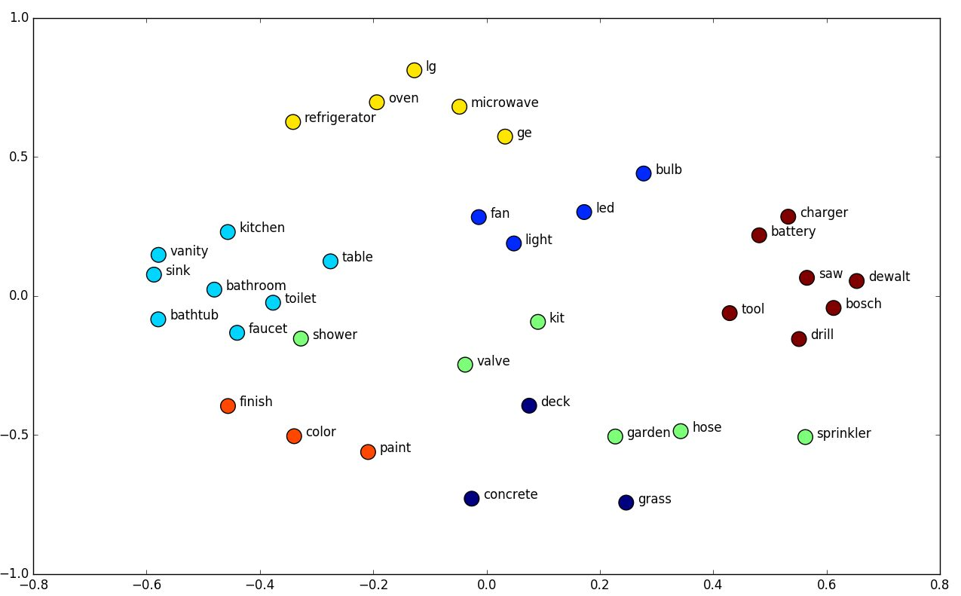

Slide 13
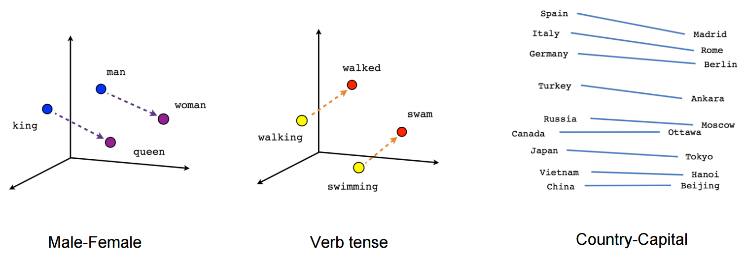

Slide 14
Training word embeddings
“The quick brown fox jumps over the lazy dog”
cat
dog
...

Slide 15
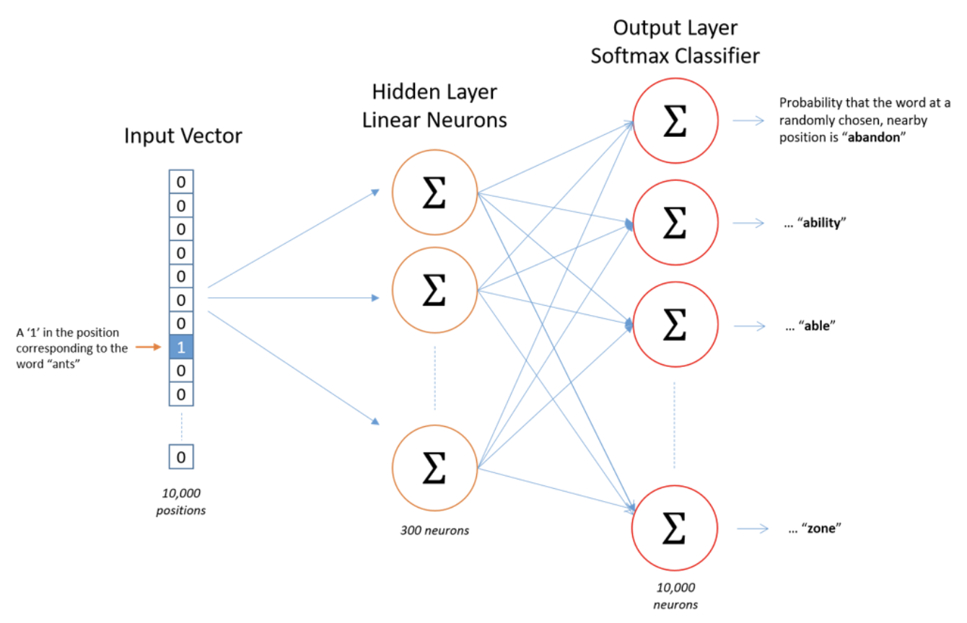
These representations are learned by NN

Slide 16
Example: document retrieval
How do I make my child eat its medicine?
3
How do I make my cat eat its medicine?
How to make my cat eat its medicine?
1
I have problems giving my Bengal its pill
1

Slide 17
Approach 3: Word Embeddings
We can vectorize every sentence by counting how often a certain word occurs in that sentence.
Advantage | Disadvantage
Does take into account word order Does take into account word meaning | The meaning of a words is not only inside the word, but also inside the context in which it is used. Use the surrounding document to add meaning This will never be perfect as a lot of the word meaning is in the cultural context.

Slide 18
2. Preprocess, to improve the quality of the embedding
There are a couple of steps you can take to preprocess your text

Slide 19
Looking at the words - removing stop words
Remove the stopwords
“The quick brown fox jumps over the lazy dog”
“quick brown fox jumps lazy dog”
Notes:
Dictionnary

Slide 20
Looking at the words - make lower case
Do we want to differentiate between a word with capital and not capital
“I am going on vacation in March”
“The soldiers will march to the battlefield”
Notes:
Dictionnary

Slide 21
Looking at the words - merging tokens
Sometimes 2 different words should be taken together to have meaning
For example ‘New York’ should be one token
Notes:
Dictionnary

Slide 22
Looking at the words - fuzziness
Using Fuzzy Matching we can match even with spelling mistakes/differences.
“The quick brown fox jumps over the lazy dog”
“The quik bronw fox jumps over the lazy dog”
Notes:
Dictionnary

Slide 23
Looking at the words - word roots
Reduce the words to their roots. Lemmatization and Stemming.
“The boy's cars are different colors”
“The boy car be different color”
Notes:
Dictionnary

Slide 24
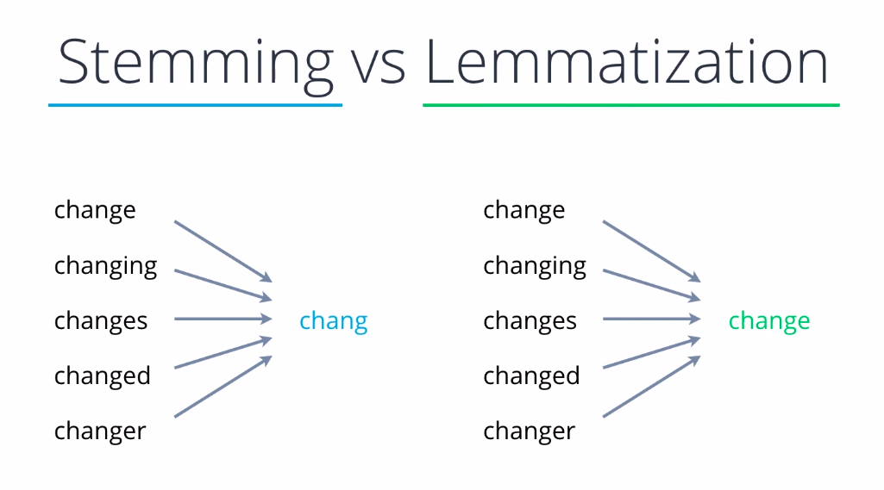
Looking at the words - word roots
Reduce the words to their roots. Lemmatization and Stemming.
Notes:
Dictionnary

Slide 25
3. Training your model
This will be for next week

